Slide 1
Software re-engineering
Reorganising and modifying existing software systems to make them more maintainable

Slide 2
Objectives
To explain why software re-engineering is a cost-effective option for system evolution
To describe the activities involved in the software re-engineering process
To distinguish between software and data re-engineering and to explain the problems of data re-engineering

Slide 3
Topics covered
Source code translation
Reverse engineering
Program structure improvement
Program modularisation
Data re-engineering

Slide 4
System re-engineering
Re-structuring or re-writing part or all of a
legacy system without changing its
functionality
Applicable where some but not all sub-systems
of a larger system require frequent
maintenance
Re-engineering involves adding effort to make
them easier to maintain. The system may be re-structured and re-documented

Slide 5
When to re-engineer
When system changes are mostly confined to
part of the system then re-engineer that part
When hardware or software support becomes
obsolete
When tools to support re-structuring are
available

Slide 6
Re-engineering advantages
Reduced risk
  There is a high risk in new software development. There may be development problems, staffing problems and specification problems
Reduced cost
  The cost of re-engineering is often significantly less than the costs of developing new software

Slide 7
Business process re-engineering
Concerned with re-designing business processes to make them more responsive and more efficient
Often reliant on the introduction of new computer systems to support the revised processes
May force software re-engineering as the legacy systems are designed to support existing processes

Slide 8
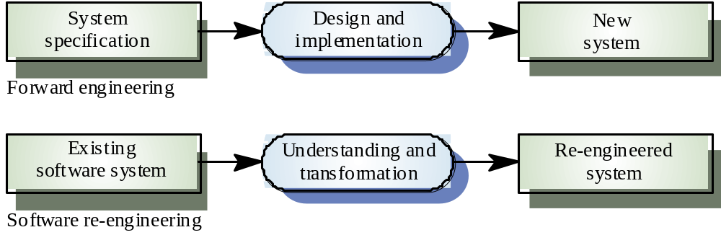
Forward engineering and re-engineering

Slide 9
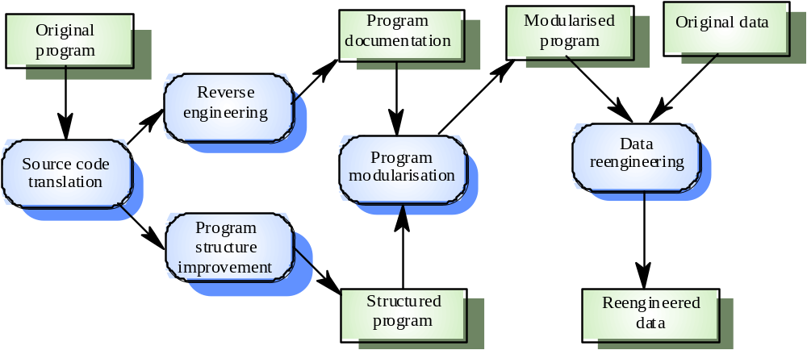
The re-engineering process

Slide 10
Re-engineering cost factors
The quality of the software to be re-engineered
The tool support available for re-engineering
The extent of the data conversion which is required
The availability of expert staff for re-engineering

Slide 11
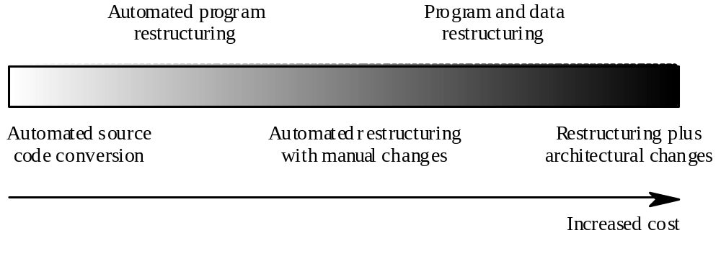
Re-engineering approaches

Slide 12
Source code translation
Involves converting the code from one language (or language version) to another e.g. FORTRAN to C
May be necessary because of:
  Hardware platform update
  Staff skill shortages
  Organisational policy changes
Only realistic if an automatic translator is available

Slide 13
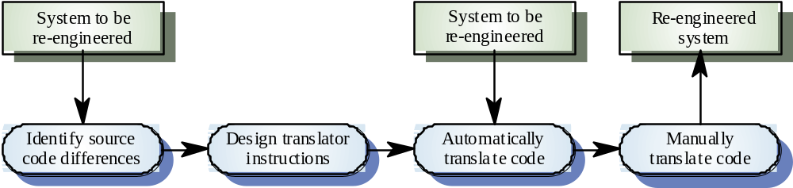
The program translation process

Slide 14
Reverse engineering
Analysing software with a view to understanding its design and specification
May be part of a re-engineering process but may also be used to re-specify a system for re-implementation
Builds a program data base and generates information from this
Program understanding tools (browsers, cross-reference generators, etc.) may be used in this process

Slide 15
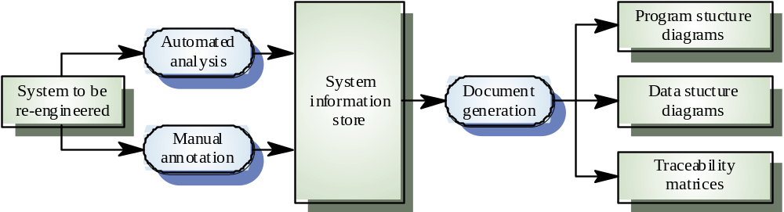
The reverse engineering process

Slide 16
Reverse engineering
Reverse engineering often precedes re-engineering but is sometimes worthwhile in its own right
  The design and specification of a system may be reverse engineered so that they can be an input to the requirements specification process for the system’s replacement
  The design and specification may be reverse engineered to support program maintenance

Slide 17
Program structure improvement
Maintenance tends to corrupt the structure of a program. It becomes harder and harder to understand
The program may be automatically restructured to remove unconditional branches
Conditions may be simplified to make them more readable

Slide 18
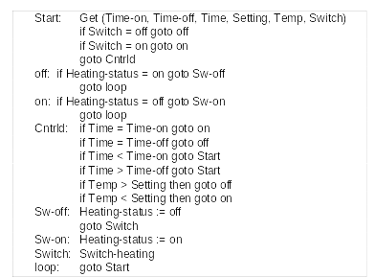
Spaghetti logic

Slide 19
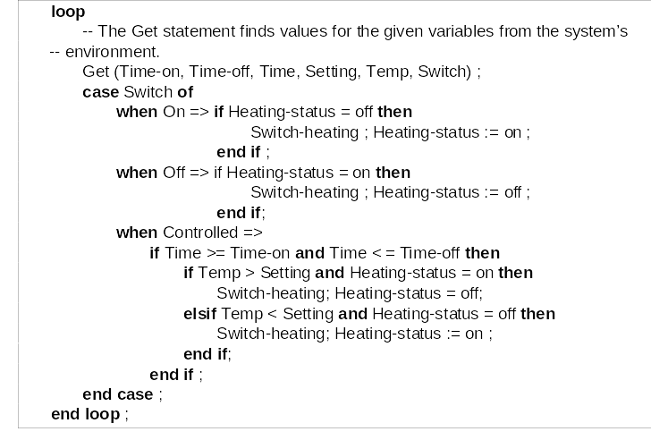
Structured control logic

Slide 20
Condition simplification
-- Complex condition
if not (A > B and (C < D or not ( E > F) ) )...
-- Simplified condition
if (A <= B and (C>= D or E > F)...

Slide 21
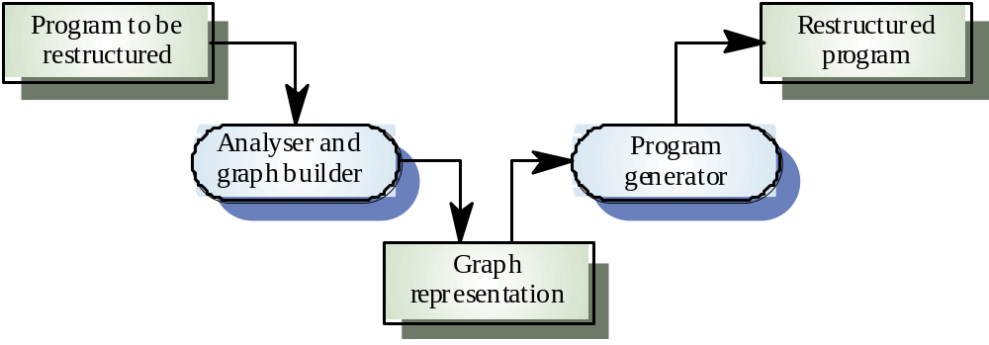
Automatic program restructuring

Slide 22
Restructuring problems
Problems with re-structuring are:
  Loss of comments
  Loss of documentation
  Heavy computational demands
Restructuring doesn’t help with poor modularisation where related components are dispersed throughout the code
The understand ability of data-driven programs may not be improved by re-structuring

Slide 23
Program modularisation
The process of re-organising a program so that related program parts are collected together in a single module
Usually a manual process that is carried out by program inspection and re-organisation

Slide 24
Module types
Data abstractions
  Abstract data types where data structures and associated operations are grouped
Hardware modules
  All functions required to interface with a hardware unit
Functional modules
  Modules containing functions that carry out closely related tasks
Process support modules
  Modules where the functions support a business process or process fragment

Slide 25
Recovering data abstractions
Many legacy systems use shared tables and global data to save memory space
Causes problems because changes have a wide impact in the system
Shared global data may be converted to objects or ADTs
  Analyse common data areas to identify logical abstractions
  Create an ADT or object for these abstractions
  Use a browser to find all data references and replace with reference to the data abstraction

Slide 26
Data abstraction recovery
Analyse common data areas to identify logical abstractions
Create an abstract data type or object class for each of these abstractions
Provide functions to access and update each field of the data abstraction
Use a program browser to find calls to these data abstractions and replace these with the new defined functions

Slide 27
Data re-engineering
Involves analysing and reorganising the data structures (and sometimes the data values) in a program
May be part of the process of migrating from a file-based system to a DBMS-based system or changing from one DBMS to another
Objective is to create a managed data environment

Slide 28
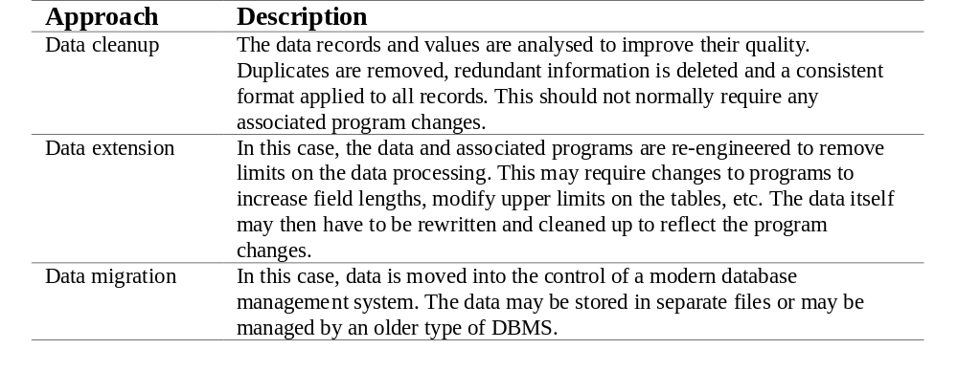
Approaches to data re-engineering

Slide 29
Data problems
End-users want data on their desktop machines rather than in a file system. They need to be able to download this data from a DBMS
Systems may have to process much more data than was originally intended by their designers
Redundant data may be stored in different formats in different places in the system

Slide 30
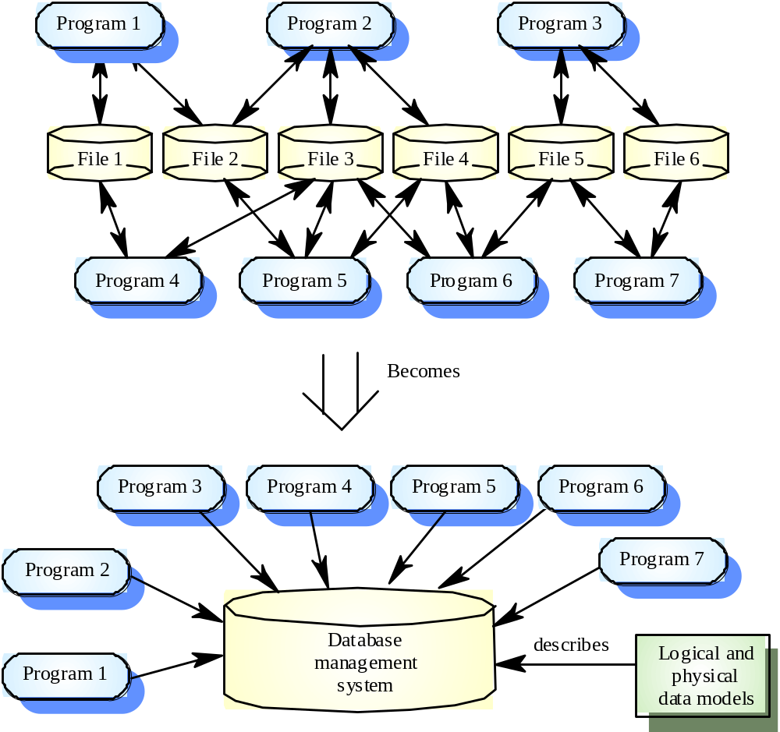
Data migration

Slide 31
Data problems
Data naming problems
  Names may be hard to understand. The same data may have different names in different programs
Field length problems
  The same item may be assigned different lengths in different programs
Record organisation problems
  Records representing the same entity may be organised differently in different programs
Hard-coded literals
No data dictionary

Slide 32
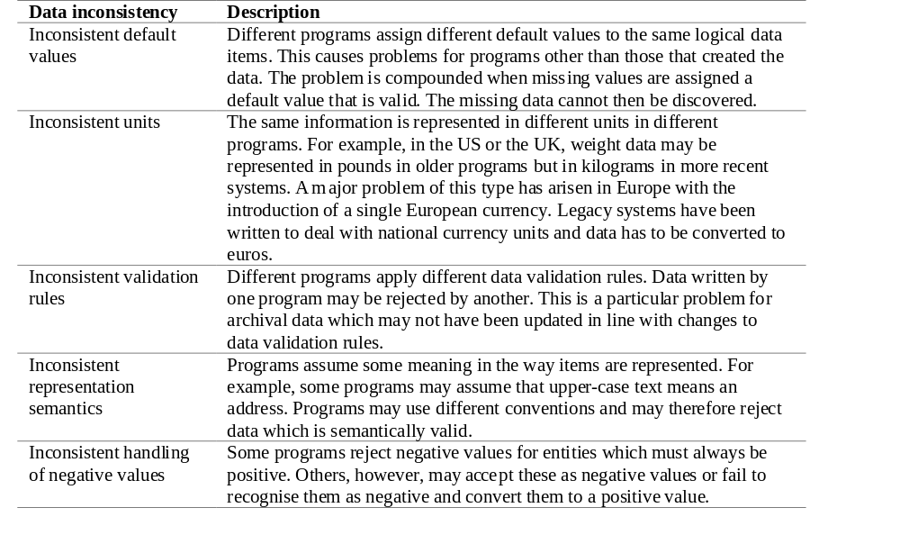
Data value inconsistencies

Slide 33
Data conversion
Data re-engineering may involve changing the data structure organisation without changing the data values
Data value conversion is very expensive. Special-purpose programs have to be written to carry out the conversion

Slide 34
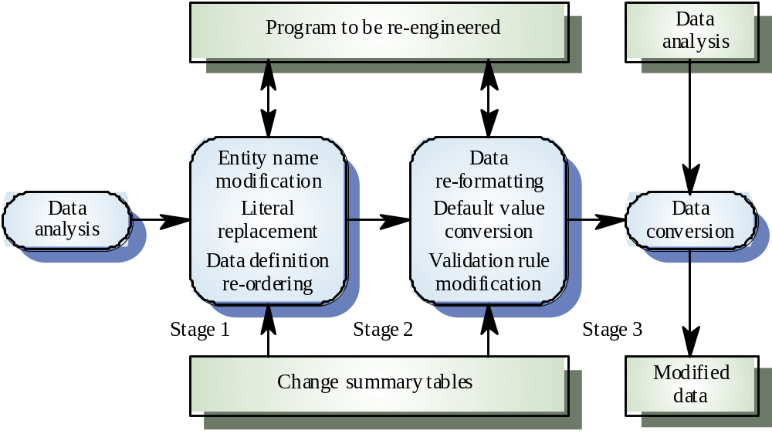
The data re-engineering process

Slide 35
Key points
The objective of re-engineering is to improve the system structure to make it easier to understand and maintain
The re-engineering process involves source code translation, reverse engineering, program structure improvement, program modularisation and data re-engineering
Source code translation is the automatic conversion of of program in one language to another

Slide 36
Key points
Reverse engineering is the process of deriving the system design and specification from its source code
Program structure improvement replaces unstructured control constructs with while loops and simple conditionals
Program modularisation involves reorganisation to group related items
Data re-engineering may be necessary because of inconsistent data management

